Slide 1

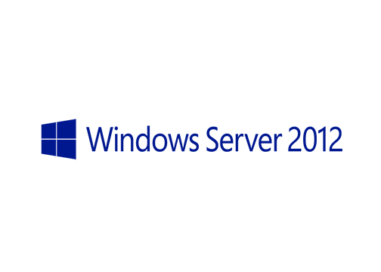
MegaSeries
Active Directory Recycle Bin

Slide 2
Info
First introduced in Windows Server 2008 R2
New to Windows Server 2012 is a GUI management tool for it
Allows you to recover deleted AD objects fast without doing an authoritative restore
Once you enable the Recycle Bin it cannot be disabled

Slide 3
https://www.youtube.com/channel/UCcZ-jLbPwNr8E_v9-65n8Iw https://github.com/itknowledge4

